Slide 1
Netflix Database Report
Home
Background
Data Model
System Design
SQL Enquiries
Tung Pok Man (20186962)
Yip Chin Hei (20189599)
Pang Ka Yin (20188944)
LI CHUN IP (20166772)
Yeung Man (20189102)

Slide 2
TABLE OF CONTENTS
01
02
03
Introduction
Data Sources and Limitations
Data Model
04
05
06
System Design
Queries and Analysis
Conclusion
01
02
03
1.1 Background
1.2 Scope of the Project
2.1 Data Sources Used
2.2 Limitations of the Study
3.1 Entities
3.2 Business Rule
3.3 Constraint of Attributes
04
05
06
4.1 Entity Design
4.2 Normalization
5.1 SQL Queries
6.1 Summary of Key Findings
6.2 Implications for Netflix
6.3 Suggestions
6.4 Acknowledgement

Slide 3
01
Introduction
Home
Background
Data Model
System Design
SQL Enquiries
01

Slide 4
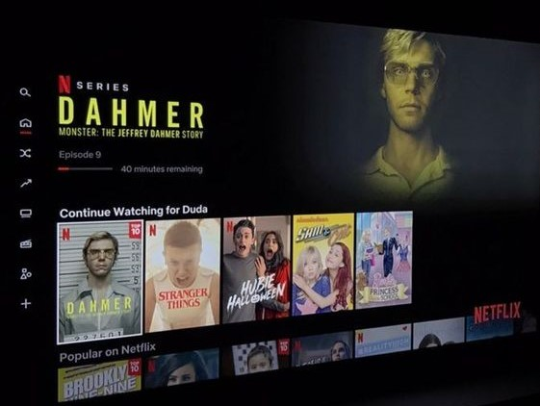
1.1 Background
NETFLIX
Home
Background
Data Model
System Design
SQL Enquiries
World's leading streaming entertainment service
Revolutionized media consumption
Over 208 million subscribers in 190+ countries
Extensive library:
TV shows, movies, documentaries, etc.

Slide 5
1.2 Scope of the project
Home
Background
Data Model
System Design
SQL Enquiries
Analyze viewing patterns of Netflix users
Provide insights on:
Most-watched shows
Average watch time per show
Demographic distribution
Geographic distribution

Slide 6
Data Sources and Limitations
Home
Background
Data Model
System Design
SQL Enquiries
02

Slide 7
2.1 Data Source Used
Obtained from publicly available sources:
Data includes:
Home
Background
Data Model
System Design
SQL Enquiries
Netflix API
Publicly available datasets on Kaggle
Most-watched shows
Average watch time
Demographic and geographic distribution of viewers

Slide 8
2.2 Limitations of the Study
Availability and accuracy of data
Sample size
Home
Background
Data Model
System Design
SQL Enquiries
Netflix API data may be incomplete or outdated
Missing or inaccurate information
Results may not represent the entire Netflix user population

Slide 9
Data Model
Home
Background
Data Model
System Design
SQL Enquiries
03

Slide 10
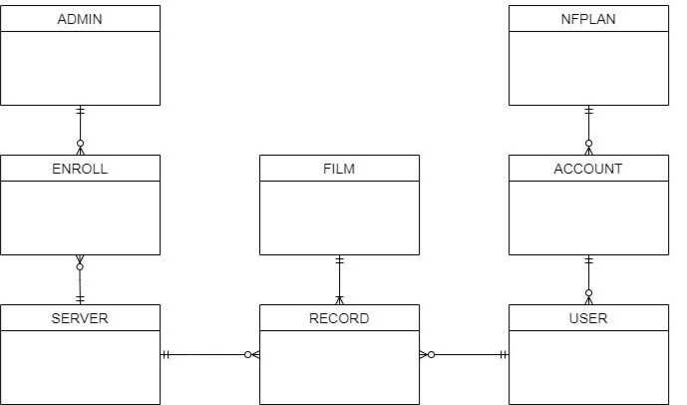
3.1 Entities
Home
Background
Data Model
System Design
SQL Enquiries
Conceptual
Data Model:

Slide 11
Attribute 1 - ADMIN
Home
Background
Data Model
System Design
SQL Enquiries
ADMIN (Admin staff number, Admin first name, Admin last name, Admin email, Admin phone number, Admin position)
This entity records some personal information and company information of admins. This is used to find if need to know the personal information of the admin who is managing the corresponding server.

Slide 12
Attribute 2 - ENROLL
Home
Background
Data Model
System Design
SQL Enquiries
ENROLL (Corresponding admin, corresponding server)
This entity is used to connect both SERVER and ADMIN, to distribute the server for the admin to manage. This is used to find which admin is managing which server, and which server is managed by which admin as well.

Slide 13
Attribute 3 - SERVER
Home
Background
Data Model
System Design
SQL Enquiries
SERVER (Server number, server country, capacity/storage of server, produce date of server)
This entity records all the server details and status. This is used to know currently which servers are fully used or seldomly used, and which servers need to upgrade or withdraw.

Slide 14
Attribute 4 - RECORD
Home
Background
Data Model
System Design
SQL Enquiries
RECORD (Film record number, corresponding user number, corresponding film number, corresponding server number, film last recorded date, film last recorded time)
This entity saves all the film-watching records made by users. This is used to know the status of movie viewing and save the record to analyze and get the data.

Slide 15
Attribute 5 - USER
Home
Background
Data Model
System Design
SQL Enquiries
USER (User number, username, user age, corresponding account number)
This entity records some user personal details. It is for data analysis.

Slide 16
Attribute 6 - ACCOUNT
Home
Background
Data Model
System Design
SQL Enquiries
ACCOUNT (account number, account email address, account country, corresponding account scribed plan)
This entity records the account information, it is for admins to search and follow the account status.

Slide 17
Attribute 7 - NFPLAN
Home
Background
Data Model
System Design
SQL Enquiries
NFPLAN (Plan number, plan name, plan price yearly, corresponding account number)
This entity records the account that has subscribed to which plan, which is a small part of the ACCOUNT.

Slide 18
Attribute 8 - FILM
Home
Background
Data Model
System Design
SQL Enquiries
FILM (Film number, film name, film genre, film establish year, film total runtime, film seasons, film episodes, film main language, film effects such as HDR, ATMOS or 4K, film director)
This entity records much information related to the film. This is for admins and users to know which films are there have released, and their details. As well as one of the significant entities for analysis.

Slide 19
3.2 Business Rules
Home
Background
Data Model
System Design
SQL Enquiries
Many accounts have one subscription.
A subscription contains many accounts.
An account can create many users.
Many users are created by one account.
A user can have many records.
Many records can be associated with a user.
A film leaves many records.
Many records are left in one film.
A server owns many records.
Many records are owned in one server.
An admin may take up to a server through enrollment.
A server is taken by many admins through enrollment.

Slide 20
3.3 Constraint of these attributes
Home
Background
Data Model
System Design
SQL Enquiries
01
All entities have a corresponding number, all numbers must be integers.
02
Emails should follow the email format.
03
The server production year should not exceed the current year.
04
The record time should not exceed the film’s running time.

Slide 21
System Design
Home
Background
Data Model
System Design
SQL Enquiries
04

Slide 22
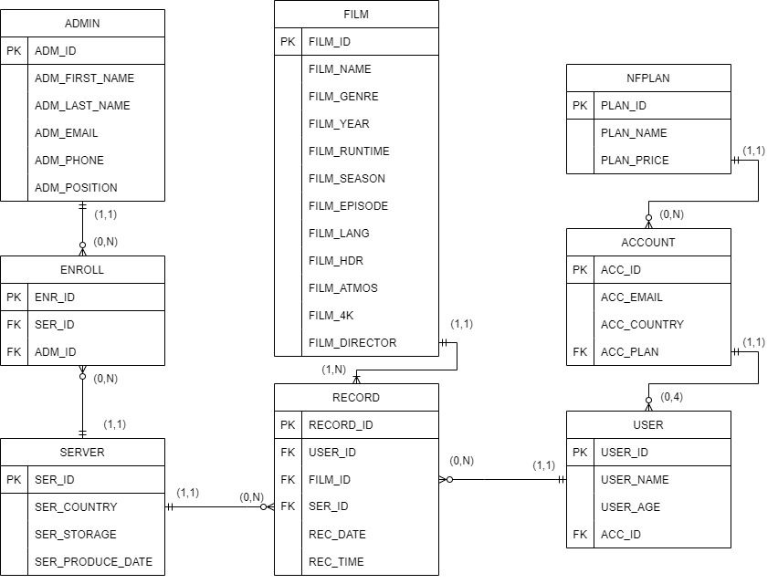
4.1 Entity Design
Home
Background
Data Model
System Design
SQL Enquiries
ER Graph:

Slide 23
Entity 1 - ADMIN
Attribute | Data Type | Not Null | PK / FK | FK Referenced Table | Unique
ADM_ID | INT | Yes | PK | / | Yes
ADM_FIRST_NAME | NVARCHAR | Yes | / | / | No
ADM_LAST_NAME | NVARCHAR | Yes | / | / | No
ADM_EMAIL | EMAIL | Yes | / | / | Yes
ADM_PHONE | INT | Yes | / | / | Yes
ADM_POSITION | NVARCHAR | No | / | / | No

Slide 24
Entity 2 - ENROLL
Attribute | Data Type | Not Null | PK / FK | FK Referenced Table | Unique
ENR_ID | INT | Yes | PK | / | Yes
SER_ID | INT | Yes | FK | SERVER | No
ADM_ID | INT | Yes | FK | ADMIN | No

Slide 25
Entity 3 - SERVER
Attribute | Data Type | Not Null | PK / FK | FK Referenced Table | Unique
SER_ID | INT | Yes | PK | / | Yes
SER_COUNTRY | NVARCHAR | Yes | / | / | No
SER_STORAGE | INT | Yes | / | / | No
SER_PRODUCE_DATE | DATE | Yes | / | / | No

Slide 26
Entity 4 – RECORD
Attribute | Data Type | Not Null | PK / FK | FK Referenced Table | Unique
REC_ID | INT | Yes | PK | / | Yes
USER_ID | INT | Yes | FK | USER | No
FILM_ID | INT | Yes | FK | FILM | No
SER_ID | INT | No | FK | SERVER | No
REC_DATE | Date | Yes | / | / | No
REC_TIME | Time | Yes | / | / | No

Slide 27
Entity 5 – USER
Attribute | Data Type | Not Null | PK / FK | FK Referenced Table | Unique
USER_ID | INT | Yes | PK | / | Yes
USER_NAME | NVARCHAR | Yes | / | / | No
USER_AGE | INT | Yes | / | / | No
ACC_ID | INT | Yes | FK | ACCOUNT | No

Slide 28
Entity 6 – ACCOUNT
Attribute | Data Type | Not Null | PK / FK | FK Referenced Table | Unique
ACC_ID | INT | Yes | PK | / | Yes
ACC_EMAIL | EMAIL | Yes | / | / | Yes
ACC_COUNTRY | NVARCHAR | Yes | / | / | No
ACC_PLAN | NVARCHAR | Yes | FK | PLAN | No

Slide 29
Entity 7 – NFPLAN
Attribute | Data Type | Not Null | PK / FK | FK Referenced Table | Unique
PLAN_ID | INT | Yes | PK | / | Yes
PLAN_NAME | NVARCHAR | Yes | / | / | Yes
PLAN_PRICE | INT | Yes | / | / | No

Slide 30
Entity 8 – FILM
Attribute | Data Type | Not Null | PK / FK | FK Referenced Table | Unique
FILM_ID | INT | Yes | PK | / | Yes
FILM_NAME | NVARCHAR | Yes | / | / | No
FILM_GENRE | NVARCHAR | Yes | / | / | No
FILM_YEAR | INT (4,0) | Yes | / | / | No
FILM_RUNTIME | Time | Yes | / | / | No
FILM_SEASON | INTEGER | No | / | / | No

Slide 31
Entity 8 – FILM (continue)
Attribute | Data Type | Not Null | PK / FK | FK Referenced Table | Unique
FILM_EPISODE | INTEGER | No | / | / | No
FILM_LANG | NVARCHAR | No | / | / | No
FILM_HDR | BOOLEAN | Yes | / | / | No
FILM_ATMOS | BOOLEAN | Yes | / | / | No
FILM_4K | BOOLEAN | Yes | / | / | No
FILM_DIRECTOR | NVARCHAR | Yes | / | / | No

Slide 32
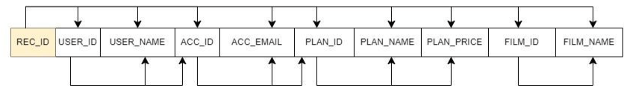


Before the Normalization
Since there are many transitive redundancy, to avoid the redundancy of data and improve the data integrity, we have normalized our table from 1NF to 3NF.

Slide 33
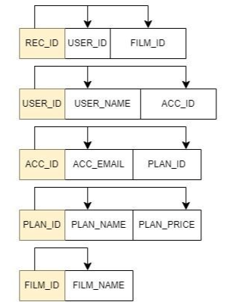
4.2 After the Normalization
Before Normalization, we can see that there is some attribute that is not only determined by REC_ID but also the USER_ID, ACC_ID, PLAN_ID, and FILM_ID.
For example, REC_ID determines PLAN_NAME and PLAN_PRICE via PLAN_ID. PLAN_ID etc are their transitional dependencies in the whole table.
Therefore, we decide to normalize it into 5 tables, which we could see in Figure 4.2.2 is more readable and clearer.

Slide 34
Queries and Entities
Home
Background
Data Model
System Design
SQL Enquiries
05
5.1 SQL Queries
5.2 Analysis of viewing patterns

Slide 35
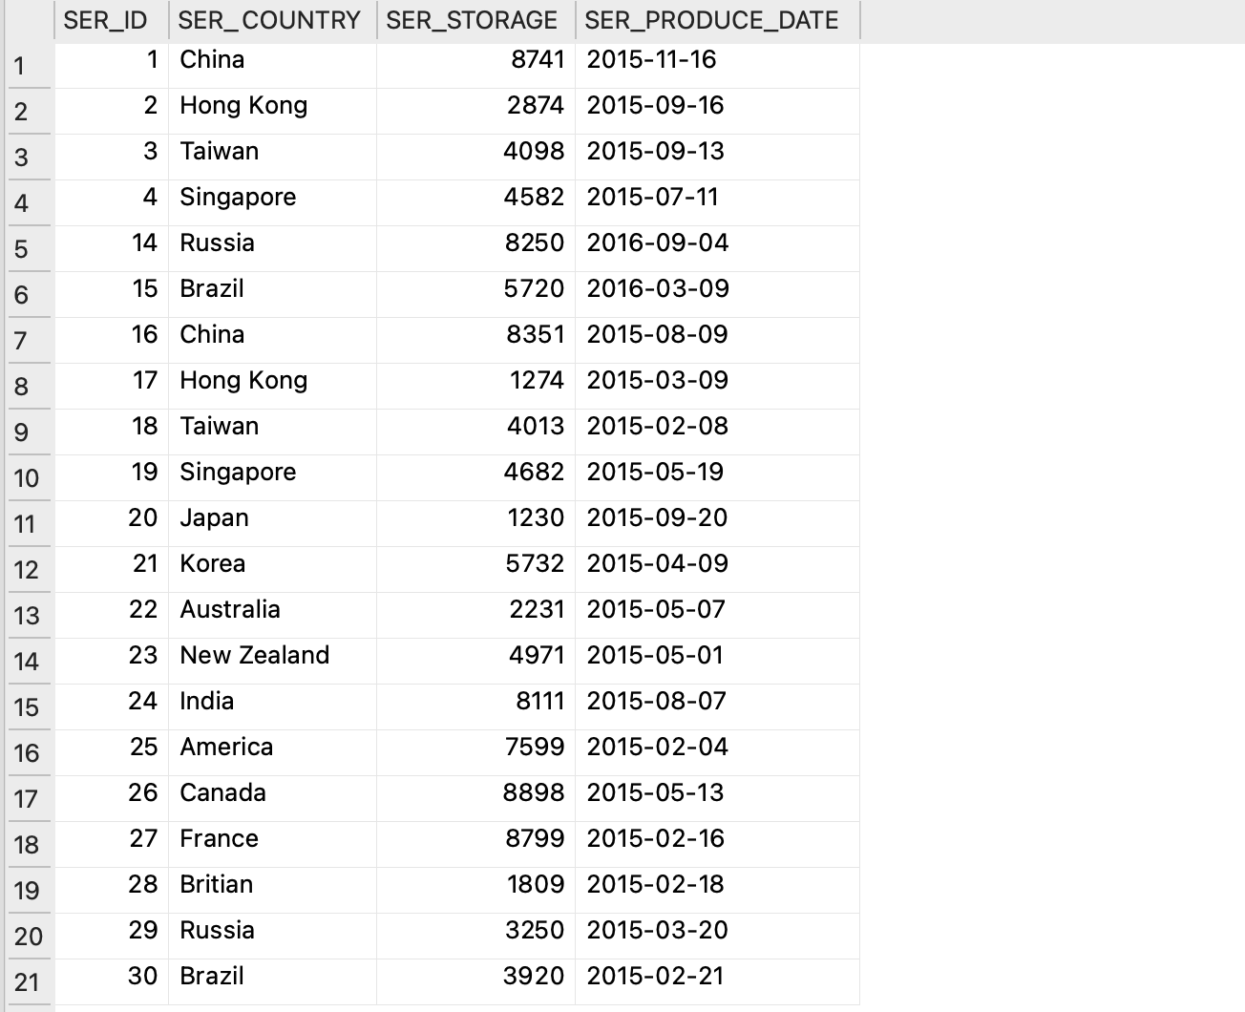
5.1 Company Perspective – Code 1
Checking Server Information
Code SELECT * FROM SERVER WHERE ser_storage < 3000 OR ser_produce_date < '2017-01-01';

Slide 36
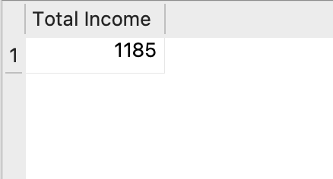
5.1 Company Perspective – Code 2
Calculate the total income from Plan
Code SELECT SUM(NFPLAN.PLAN_PRICE) AS 'Total Income' FROM Account, nfplan WHERE account.ACC_PLAN = nfplan.PLAN_ID;

Slide 37
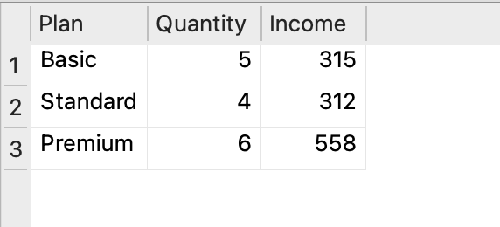
5.1 Company Perspective – Code 3
Most Popular / Effectiveness Plan
Code SELECT NFPLAN.PLAN_NAME AS 'Plan', COUNT(account.ACC_PLAN) AS 'Quantity', COUNT(account.ACC_PLAN)*NFPLAN.PLAN_PRICE AS 'Income' FROM Account, nfplan WHERE account.ACC_PLAN = nfplan.PLAN_ID GROUP BY account.ACC_PLAN;

Slide 38
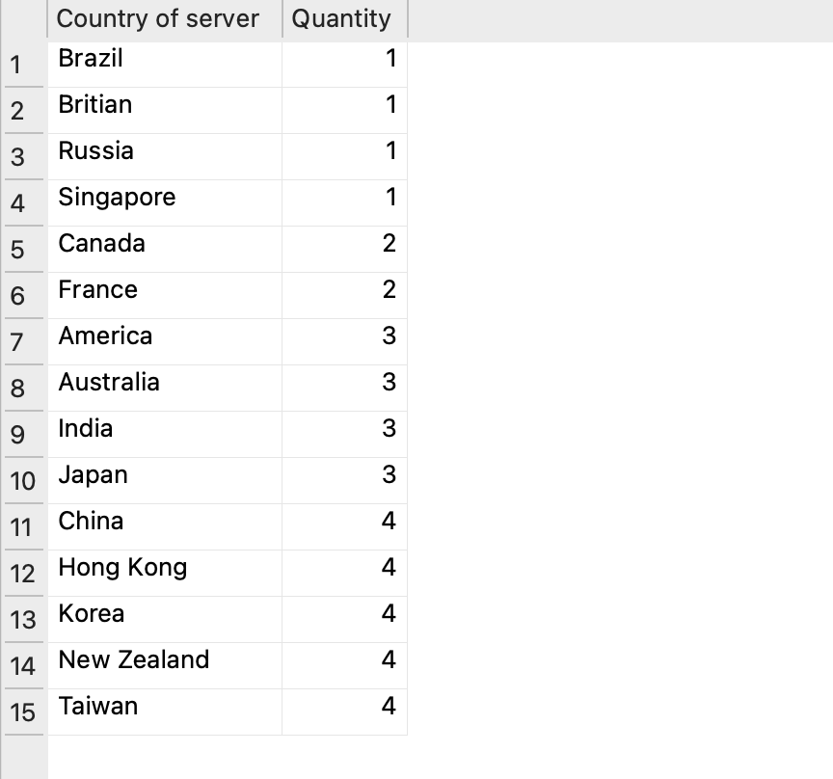
5.1 Company Perspective – Code 4
Quantity of Record in Each Server
Code SELECT server.SER_COUNTRY AS 'Country of server', COUNT(*) AS 'Quantity' FROM server, record WHERE server.SER_ID = record.SER_ID GROUP BY server.SER_COUNTRY ORDER BY COUNT(*);

Slide 39
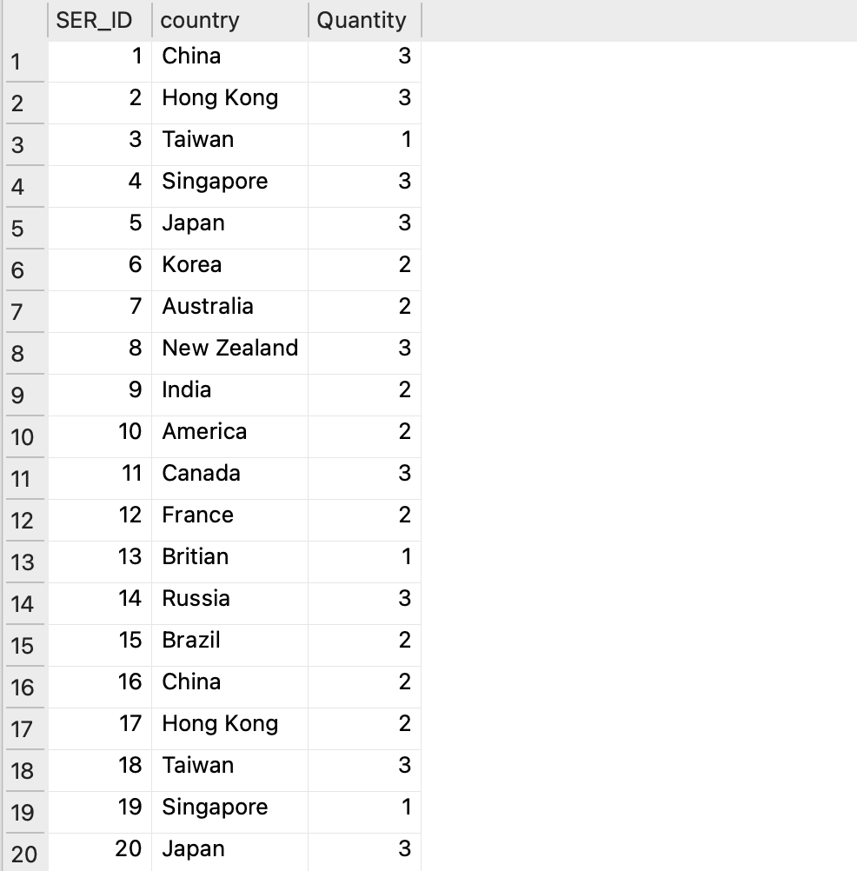
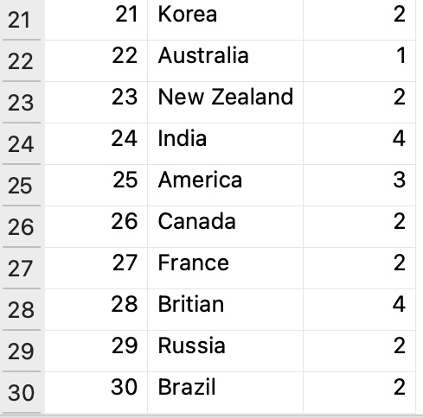
5.1 Company Perspective – Code 5
Human Resources Allocation
Code SELECT server.SER_ID, server.SER_COUNTRY AS 'country', COUNT(*) AS 'Quantity' FROM admin, enroll, server WHERE admin.ADM_ID = enroll.ADM_ID AND enroll.SER_ID = server.SER_ID GROUP BY server.SER_ID;

Slide 40
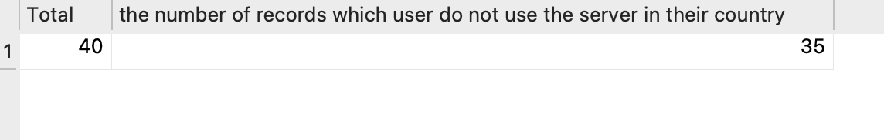
5.1 Company Perspective – Code 6
Match With Country (VPN)
Code SELECT count(*) AS Total, SUM(CASE WHEN server.SER_COUNTRY <> account.ACC_COUNTRY THEN 1 ELSE 0 END) AS "the number of records which user does not use the server in their country" FROM server, record, account, USER WHERE server.SER_ID = record.SER_ID AND record.USER_ID = USER.USER_ID AND USER.ACC_ID = account.ACC_ID;

Slide 41
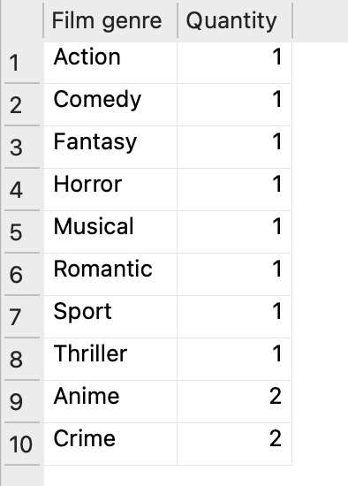
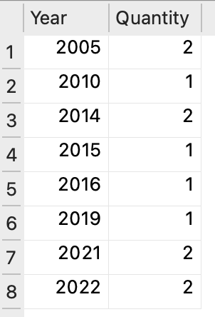
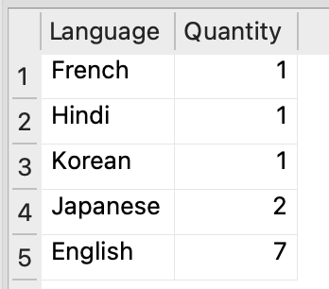
5.1 Company Perspective – Code 7
Count Film Group by Language / Year / Genre
Code SELECT film.FILM_LANG AS 'Language', COUNT(*) AS 'Quantity' FROM film GROUP BY film.FILM_LANG ORDER BY COUNT(*);

Slide 42
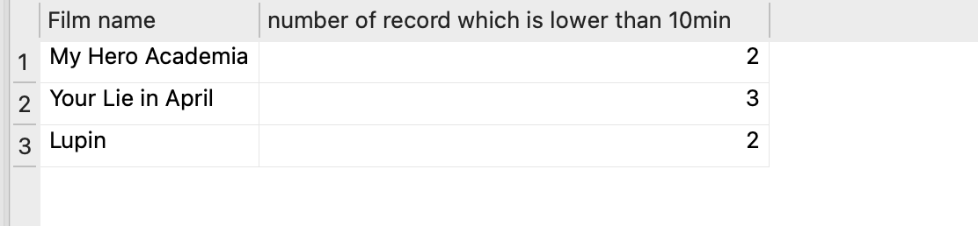
5.2 Customers' Perspective – Code 1
Least Popular Film
Code SELECT film.FILM_NAME AS 'Film name', COUNT(*) AS 'number of records which is lower than 10min' FROM film, record WHERE film.FILM_ID = record.FILM_ID AND record.REC_TIME < '00:10:00' GROUP BY film.FILM_ID;

Slide 43
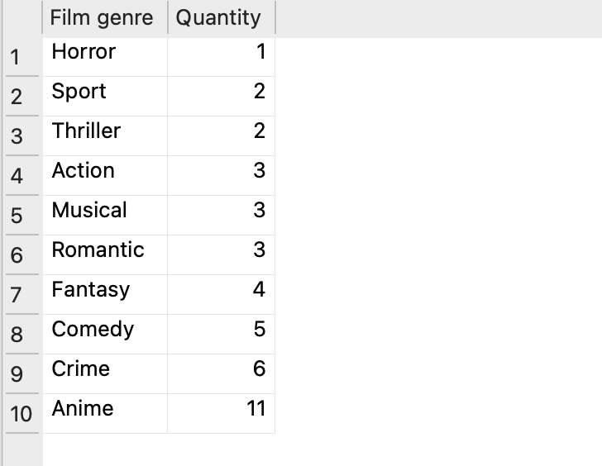
5.2 Customers' Perspective – Code 2
Most Popular Film Genre
Code SELECT film.FILM_GENRE AS 'Film genre', COUNT(record.FILM_ID) AS 'Quantity' FROM film, record WHERE film.FILM_ID = record.FILM_ID GROUP BY film.FILM_GENRE ORDER BY COUNT(record.FILM_ID);

Slide 44
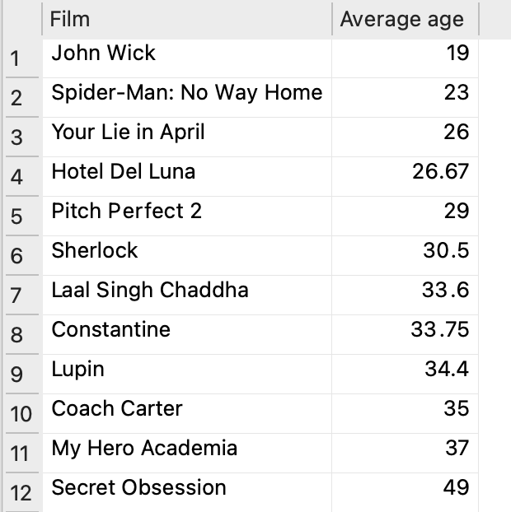
5.2 Customers' Perspective – Code 3
Target Audience of Each Film
Code SELECT film.FILM_NAME AS 'Film', ROUND(AVG(user.USER_AGE),2) AS 'Average age' FROM film, user, record WHERE film.FILM_ID = record.FILM_ID AND record.USER_ID = user.USER_ID GROUP BY film.FILM_ID ORDER BY AVG(user.USER_AGE);

Slide 45
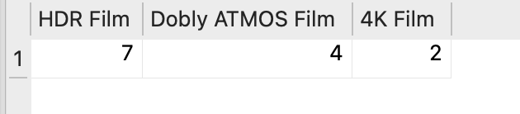
5.2 Customers' Perspective – Code 4
Calculate the number of Effect in all Film
Code SELECT SUM(CASE WHEN FILM_HDR='TRUE' THEN 1 ELSE 0 END) AS 'HDR Film', SUM(CASE WHEN FILM_ATMOS='TRUE' THEN 1 ELSE 0 END) AS 'Dobly ATMOS Film', SUM(CASE WHEN FILM_4K='TRUE' THEN 1 ELSE 0 END) AS '4K Film' FROM film;

Slide 46
Conclusion
Home
Background
Data Model
System Design
SQL Enquiries
06

Slide 47
6.1 Summary of Key Findings
Home
Background
Data Model
System Design
SQL Enquiries
Diverse user base with varying preferences
Subscription plans: Standard and Mobile most popular
Importance of optimizing subscription plans
Users prefer non-local servers
Focus on enhancing server performance in popular regions
Diverse film library
Genres, languages, and release years
Continue updating content to maintain wide appeal
Significant viewership with less than 10-minute watch time
Investigate reasons behind this behavior

Slide 48
6.2 Implications
Tailor pricing and features for popular subscription plans
Introduce mobile-specific features
Offer competitive pricing to attract and retain customers
Improve server performance in popular regions
Enhance reliability and availability for seamless streaming
Focus on content acquisition and production
Maintain diverse offerings for a global audience
Investigate viewers watching films for less than 10 minutes
Gain insights on user behavior and preferences
Improve content recommendation algorithms and user interface
Enhance viewer engagement and satisfaction

Slide 49
6.3 Suggestions
Investigate customer preferences in-depth
Subscription, pricing, content, streaming quality
Optimize subscription offerings
Understand user behavior and satisfaction
Reasons for varying watch times
Enhance user experience
Analyze server performance, satisfaction, and VPN usage
Inform server investments and content distribution strategies
Assess competitive landscape
Identify rising trends and new marketing ideas
Ensure awareness of market changes

Slide 50
Home
Background
Data Model
System Design
SQL Enquiries
Q & A Section
Thank You For Watching !

Slide 51
Reference

Slide 52
Appendix

